Slide 1
Naïve Bayes Classifiers
By U17CO110

Slide 2
What is a classifier?
A classifier is a machine learning model that is used to discriminate different objects based on certain features
Applications -
Life Science: Predicting tumor cells as benign or malignant
Security: Classifying credit card transactions as legitimate or fraudulent
Prediction: Weather, voting, political dynamics, etc. and many more..
Types –
Supervised Classification
Unsupervised Classification

Slide 3
Naïve Bayes Classifiers
Naive Bayes classifiers are a collection of classification algorithms based on Bayes’ Theorem. It is not a single algorithm but a family of algorithms where all of them share a common principle, i.e. every pair of features being classified is independent of each other.

Slide 4
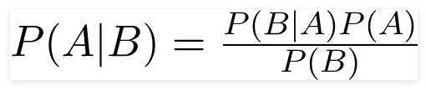
Bayes’ Theorem
Bayes’ Theorem finds the probability of an event occurring given the probability of another event that has already occurred. Bayes’ theorem is stated mathematically as the following equation:
where A and B are events and P(B) ? 0.
Basically, we are trying to find probability of event A, given the event B is true. Event B is also termed as evidence.
P(A) is the priori of A (the prior probability, i.e. Probability of event before evidence is seen). The evidence is an attribute value of an unknown instance(here, it is event B).
P(A|B) is a posteriori probability of B, i.e. probability of event after evidence is seen.

Slide 5
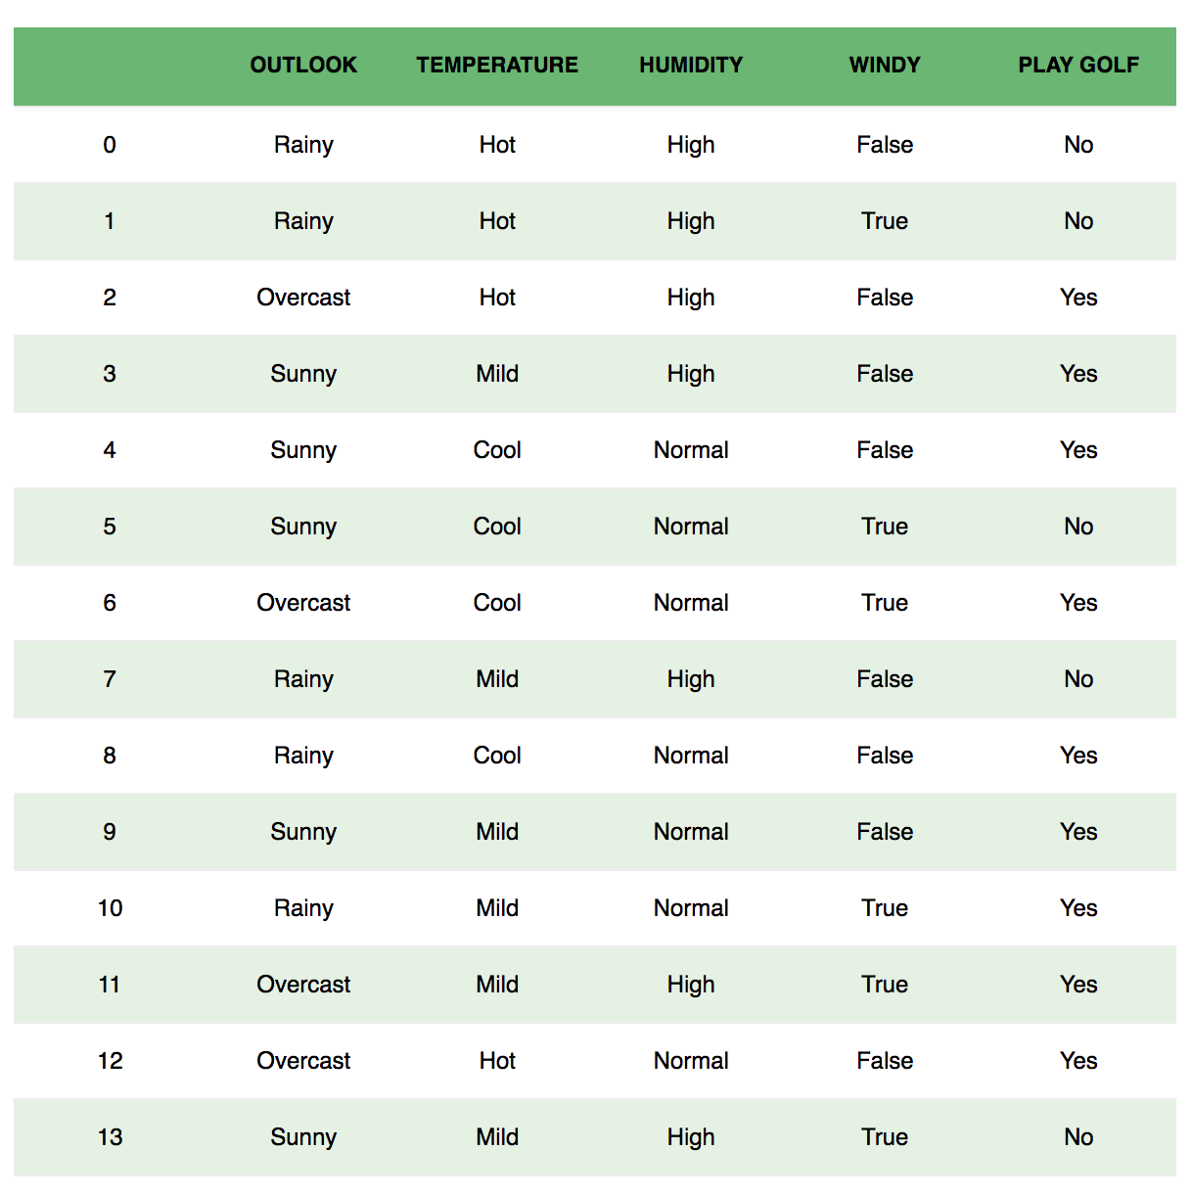

Slide 6
Example Dataset
The dataset is divided into two parts, namely, feature matrix and the response vector:
Feature matrix contains all the vectors(rows) of dataset in which each vector consists of the value of dependent features. In above dataset, features are ‘Outlook’, ‘Temperature’, ‘Humidity’ and ‘Windy’.
Response vector contains the value of class variable(prediction or output) for each row of feature matrix. In above dataset, the class variable name is ‘Play golf’.

Slide 7
Assumption
The fundamental Naive Bayes assumption is that each feature makes an:
independent
equal
contribution to the outcome.
With relation to our dataset, this concept can be understood as:
We assume that no pair of features are dependent. For example, the temperature being ‘Hot’ has nothing to do with the humidity or the outlook being ‘Rainy’ has no effect on the winds. Hence, the features are assumed to be independent.
Secondly, each feature is given the same weight(or importance). For example, knowing only temperature and humidity alone can’t predict the outcome accurately. None of the attributes is irrelevant and assumed to be contributing equally to the outcome.

Slide 8
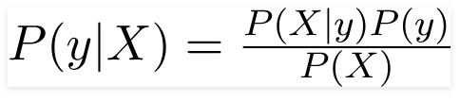

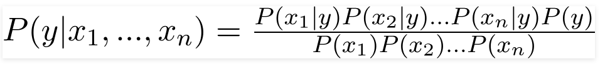
The variable y is the class variable(play golf), which represents if it is suitable to play golf or not given the conditions. Variable X represent the parameters/features.
Now, its time to put a naive assumption to the Bayes’ theorem, which is, independence among the features. So now, we split evidence into the independent parts.

Slide 9


Now, you can obtain the values for each by looking at the dataset and substitute them into the equation. For all entries in the dataset, the denominator does not change, it remain static. Therefore, the denominator can be removed and a proportionality can be introduced.
In our case, the class variable(y) has only two outcomes, yes or no. There could be cases where the classification could be multivariate. Therefore, we need to find the class y with maximum probability.

Slide 10
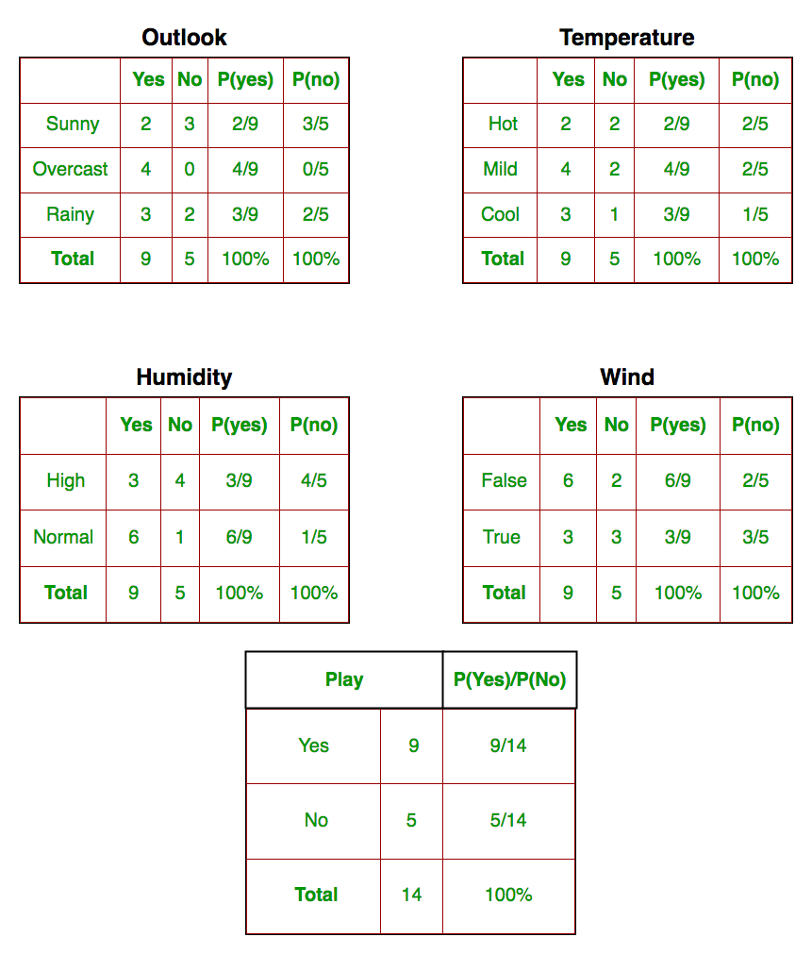

Slide 11
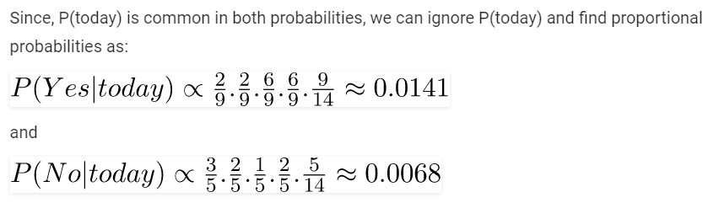
Testing on new data
today = (Sunny, Hot, Normal, False)
So, probability of playing golf is given by:
and probability to not play golf is given by:

Slide 12

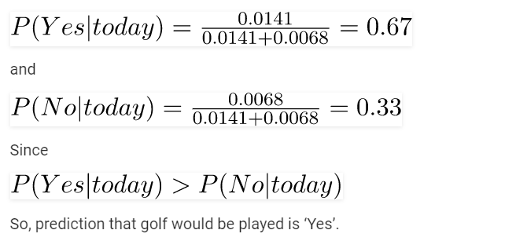
These numbers can be converted into a probability by making the sum equal to 1 (normalization):

Slide 13
What if I encounter probability values of 0?
There is a simple trick to avoid this problem. We can assume that our training database, D, is so large that adding one to each count that we need would only make a negligible difference in the estimated probability value, yet would conveniently avoid the case of probability values of zero. This technique for probability estimation is known as the Laplacian correction or Laplace estimator.
Ex. Suppose a dataset with 1000 tuples, income=low (0), income= medium (990), and income=high(10),
Use Laplacian correction (or Laplacian estimator)
Adding 1 to each case
Prob(income = low) = 1/1003
Prob(income = medium) = 991/1003
Prob(income = high) = 11/1003
The “corrected” prob. estimates are close to their “uncorrected” counterparts

Slide 14
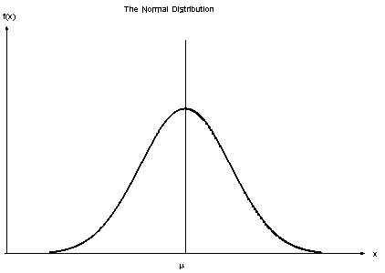
Types of Naïve Bayes Classifiers
The method that we discussed above is applicable for discrete data. In case of continuous data, we need to make some assumptions regarding the distribution of values of each feature. The different naive Bayes classifiers differ mainly by the assumptions they make regarding the distribution of P(x_{i} | y).
Gaussian Naïve Bayes: When the predictors take up a continuous value and are not discrete, we assume that these values are sampled from a gaussian distribution.

Slide 15
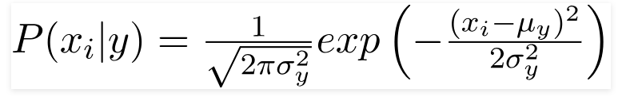
Since the way the values are present in the dataset changes, the formula for conditional probability changes to
Multinomial Naive Bayes: Feature vectors represent the frequencies with which certain events have been generated by a multinomial distribution. This is the event model typically used for document classification.
Bernoulli Naive Bayes: In the multivariate Bernoulli event model, features are independent Booleans (binary variables) describing inputs. Like the multinomial model, this model is popular for document classification tasks, where binary term occurrence(i.e. a word occurs in a document or not) features are used rather than term frequencies(i.e. frequency of a word in the document).

Slide 16
How effective are Bayesian classifiers?
Various empirical studies of this classifier in comparison to decision tree and neural network classifiers have found it to be comparable in some domains
Bayesian classifiers are also useful in that they provide a theoretical justification for other classifiers that do not explicitly use Bayes’ theorem

Slide 17
References
https://towardsdatascience.com/naive-bayes-classifier-81d512f50a7c
https://en.wikipedia.org/wiki/Naive_Bayes_classifier
Data Mining: Concepts and Techniques, (3rd Edn.), Jiawei Han, Micheline Kamber, Morgan Kaufmann, 2015.

Slide 18
THANK YOU

